Slide 1
TMDB 5000 Movie Dataset
Presented By
Name : College name : Jayaraj annapackiam CSI college of engineering
Department : Mechanical engineering

Slide 2
OUTLINE
Problem Statement
Proposed System/Solution
System Development Approach
Algorithm & Deployment
Result
Conclusion
Future Scope
References

Slide 3
Problem Statement
The TMDB 5000 Movie Dataset contains detailed information about movies, including title, genre, release date, budget, revenue, cast, crew, and ratings.
Despite the rich information, it is challenging to understand the key factors that contribute to a movie's commercial success or critical acclaim.
The objective of this project is to analyze the TMDB 5000 Movie Dataset to identify trends and patterns that predict a movie's success in terms of revenue and critical reception.
Success metrics can include revenue, profit, or audience ratings.
Research Questions: What characteristics (such as genre, budget, director, or cast) are most strongly associated with high box office revenue? Is there a correlation between critical acclaim and commercial success? Can we predict a movie's revenue or rating based on its attributes?
This study will focus on data exploration, analysis, and visualization to uncover insights and build predictive models.
The insights from this analysis can guide filmmakers, producers, and investors in making informed decisions about movie production and marketing strategies.

Slide 4
Proposed Solution
Data Preparation and Exploration:
Data Cleaning: Begin with cleaning the TMDB 5000 Movie Dataset by handling missing values, duplicate records, and outliers.
Data Transformation: Convert relevant fields (such as dates, budget, and revenue) into consistent formats. Extract additional information from complex data structures like JSON.
Exploratory Data Analysis (EDA): Perform EDA to understand the distribution of key variables and identify relationships between them. Create visualizations to illustrate these insights.
Feature Engineering:
Derive New Features: Create new features that could be useful for prediction, such as budget-to-revenue ratio, number of genres, or average rating by the cast.
Feature Scaling: Normalize or standardize features as needed for analysis and modeling.
Model Building and Prediction :
Correlation Analysis: Use statistical methods to identify correlations between variables. Assess how strongly various features are related to revenue, profit, and ratings.
Predictive Models: Build machine learning models to predict a movie's success based on its attributes. Consider models like linear regression, decision trees, or ensemble methods.
Model Evaluation: Evaluate the models' performance using appropriate metrics such as mean absolute error, root mean square error, or accuracy. Use cross-validation to ensure robustness.

Slide 5
System Approach
Data Ingestion and Storage :
Data Sources: The dataset contains information on over 5000 movies, including attributes like budget, revenue, cast, crew, genres, and ratings. This data is sourced from TMDB and provided as a downloadable dataset.
Data Storage: Store the dataset in a structured format (e.g., CSV or a relational database) for easy access and querying. Tools like Pandas, SQL, or similar database management systems are suitable for storage and manipulation.
Data Cleaning and Transformation :
Data Quality: Check for missing values, duplicates, and outliers. Apply data cleaning techniques to ensure accuracy and consistency.
Data Transformation: Convert data to suitable formats for analysis. This includes parsing dates, splitting complex data structures (like JSON), and normalizing numerical features.
Feature Engineering: Create additional features to enhance predictive modeling, such as budget-torevenue ratio, number of genres, or popular director/actor indicators.
Exploratory Data Analysis (EDA) :
Data Exploration: Use EDA to understand the distribution and relationships within the data. Employ summary statistics and visualizations to identify trends and patterns.
Visualization Tools: Utilize libraries like Matplotlib, Seaborn, or Plotly to create informative visualizations for both qualitative and quantitative analysis

Slide 6
Algorithm & Deployment
Algorithm Development
Data Collection and Preparation :
Load Dataset: Load the TMDB 5000 Movie Dataset into a suitable data structure, such as a DataFrame in Python with Pandas.
Handle Missing Data: Identify missing values in the dataset. Apply imputation strategies or drop rows/columns with excessive missing data.
Remove Duplicates: Check for duplicate entries and remove them to ensure data integrity.
Outlier Detection: Identify and handle outliers in numerical features (e.g., budget, revenue). Consider using techniques like z-scores or interquartile range (IQR).
Exploratory Data Analysis :
Summary Statistics: Compute summary statistics for the key features to understand the data's basic properties.
Data Visualization: Create visualizations (e.g., histograms, scatter plots, box plots) to identify trends and correlations among variables.
Correlation Analysis: Assess the relationships between features using correlation matrices or scatter plots. Identify which features are most closely associated with revenue or ratings.
Model Building and Training :
Model Selection: Choose a machine learning algorithm for predictive modeling. Common choices include linear regression, decision trees, random forest, or gradient boosting.
Data Splitting: Split the dataset into training and test sets (e.g., 80/20 split) to ensure unbiased model evaluation.
Model Training: Train the chosen model using the training set. Use cross-validation to avoid overfitting and improve model robustness.
Hyperparameter Tuning: Adjust hyperparameters to optimize model performance. Techniques like grid search or random search can be used for tuning

Slide 7
Deployment
Objective of Deployment :
Define the purpose of deployment: Is it to provide predictive insights, offer interactive data visualization, or create a decision-making tool for movie producers and stakeholders?
Identify the end-users: This could be data scientists, business analysts, or stakeholders in the movie industry
Environment Setup :
Hosting Platform: Choose a platform for deployment, such as a cloud service (e.g., AWS, Google Cloud, Azure) or an on-premises server, based on scalability and cost considerations.
Development Environment: Ensure your development environment supports the tools and libraries used for analysis and modeling. Use containers (e.g., Docker) for consistent deployment across environments.
Model Deployment
Model Serialization: If deploying a predictive model, serialize the model (e.g., with Pickle or Joblib) to save its state for later use.
API Development: Create an API to allow other applications to interact with the model. Frameworks like Flask or FastAPI are suitable for building RESTful APIs.
Endpoints and Operations: Define endpoints for common operations, such as predicting movie revenue based on input attributes or fetching movie insights.
Data Management
Data Storage: Determine where the dataset will be stored and how it will be accessed. This could be a database, a cloud-based storage service, or a simple file system.
Data Security: Implement data security measures to protect sensitive information. Use encryption for data in transit and at rest, and set access controls. Data Updates: Establish a process for updating the dataset as new movies are released or additional data is collected.

Slide 8
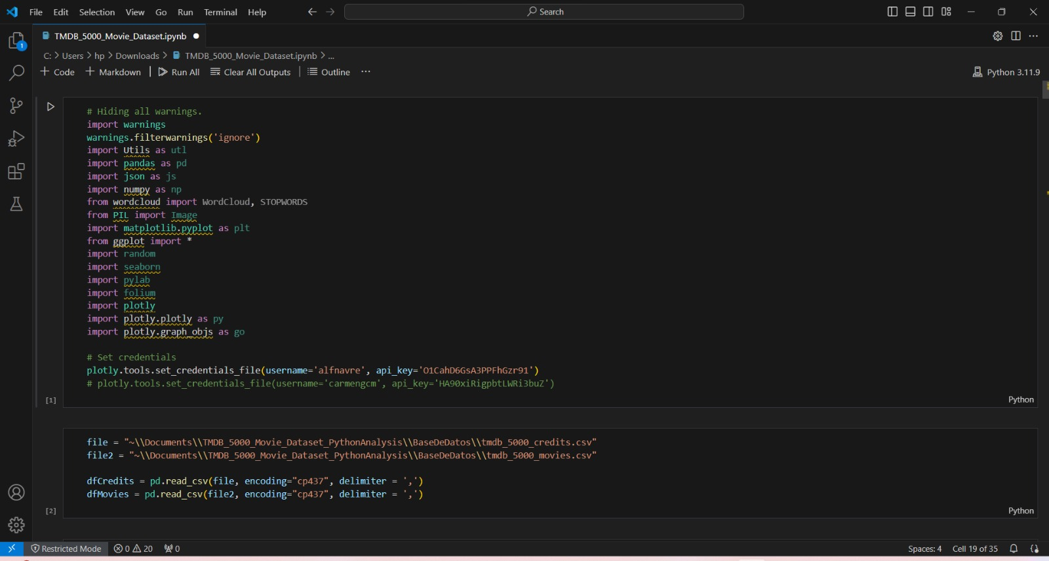
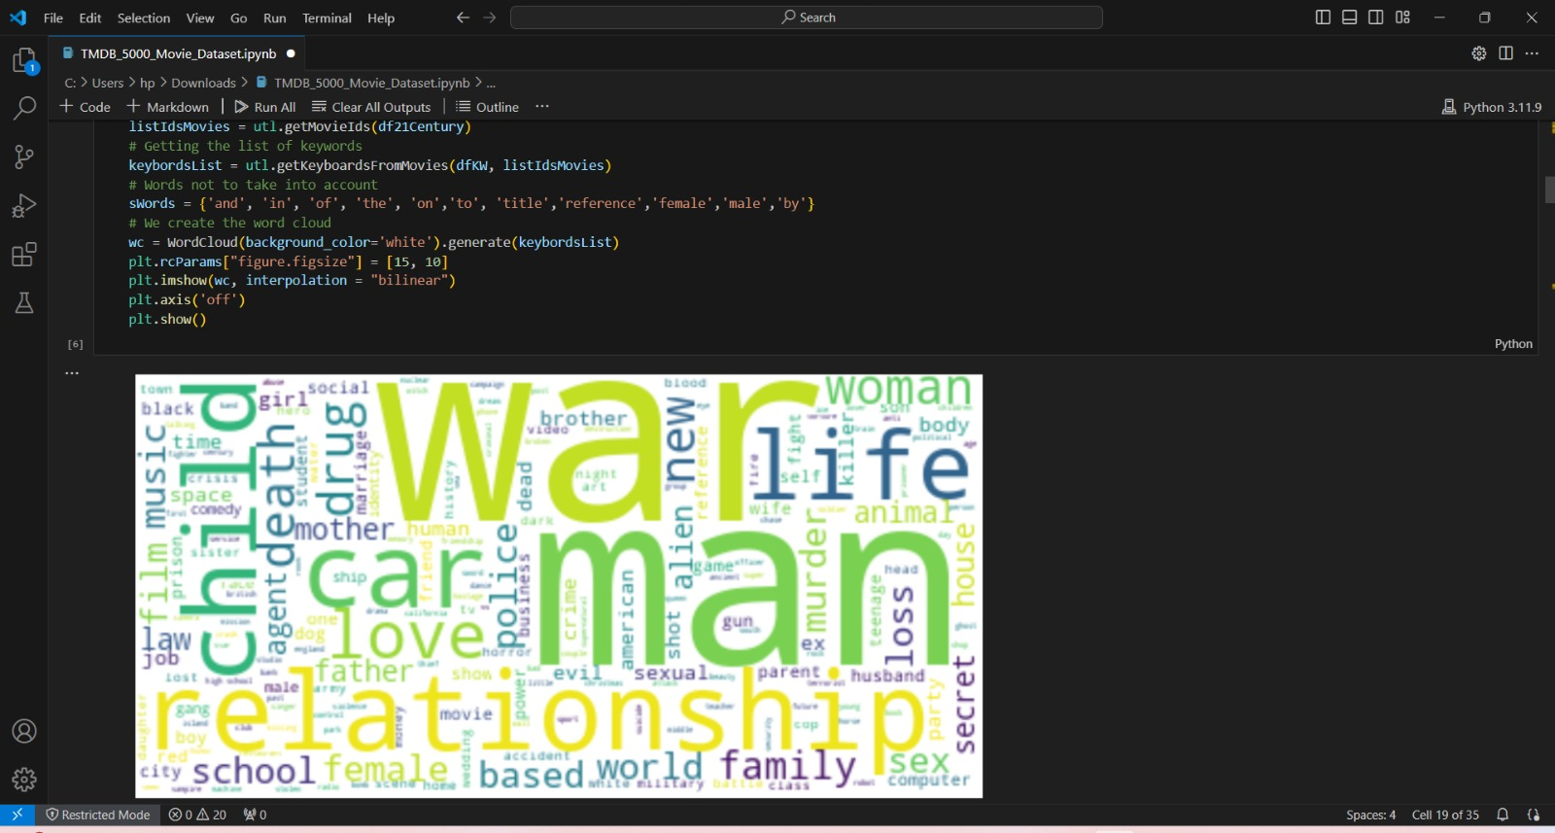
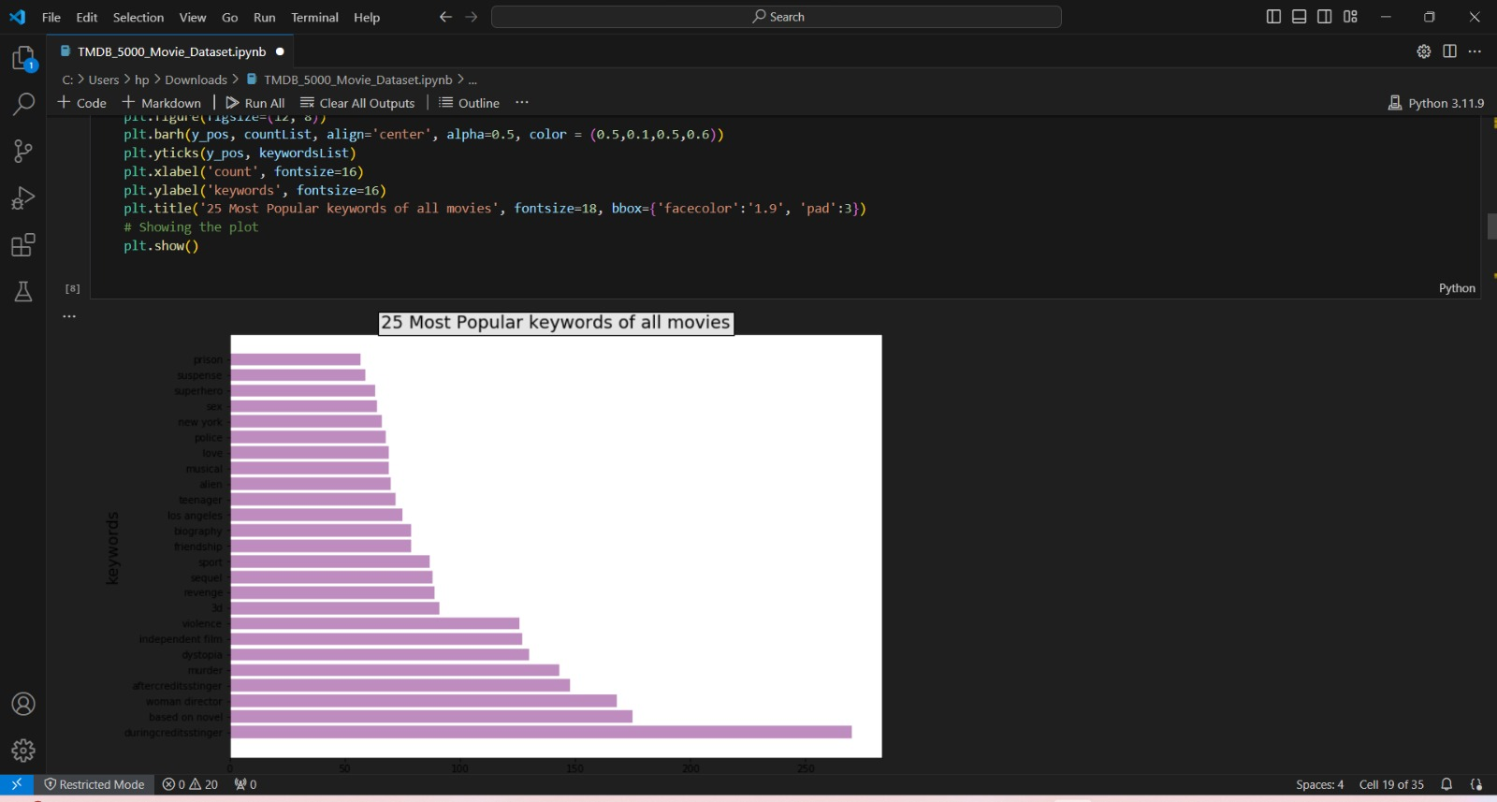
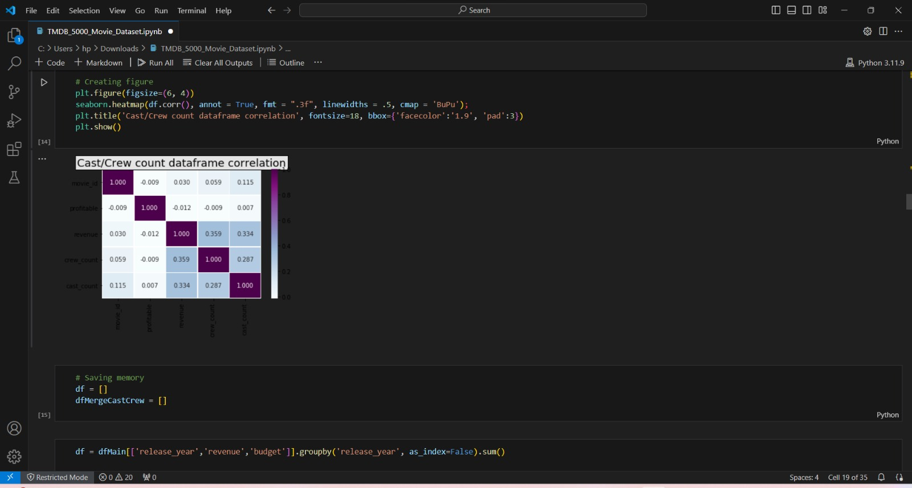
Result

Slide 9
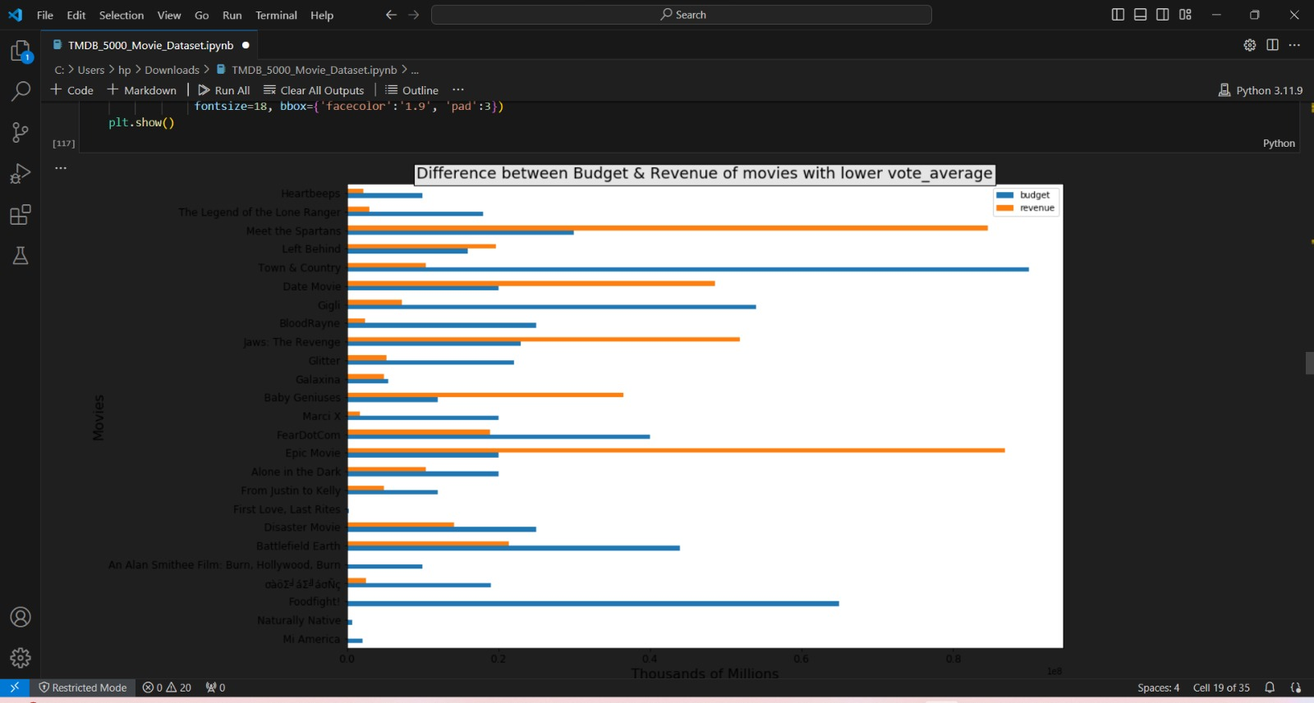
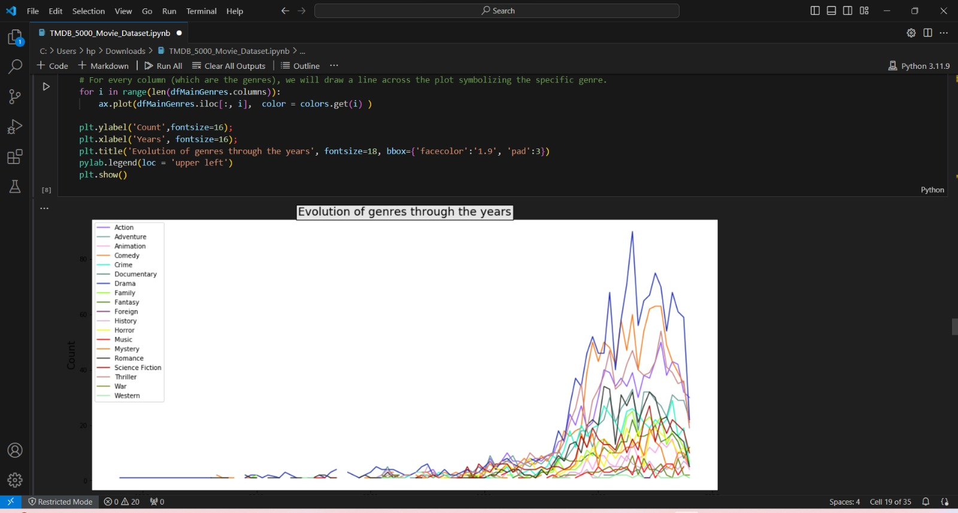
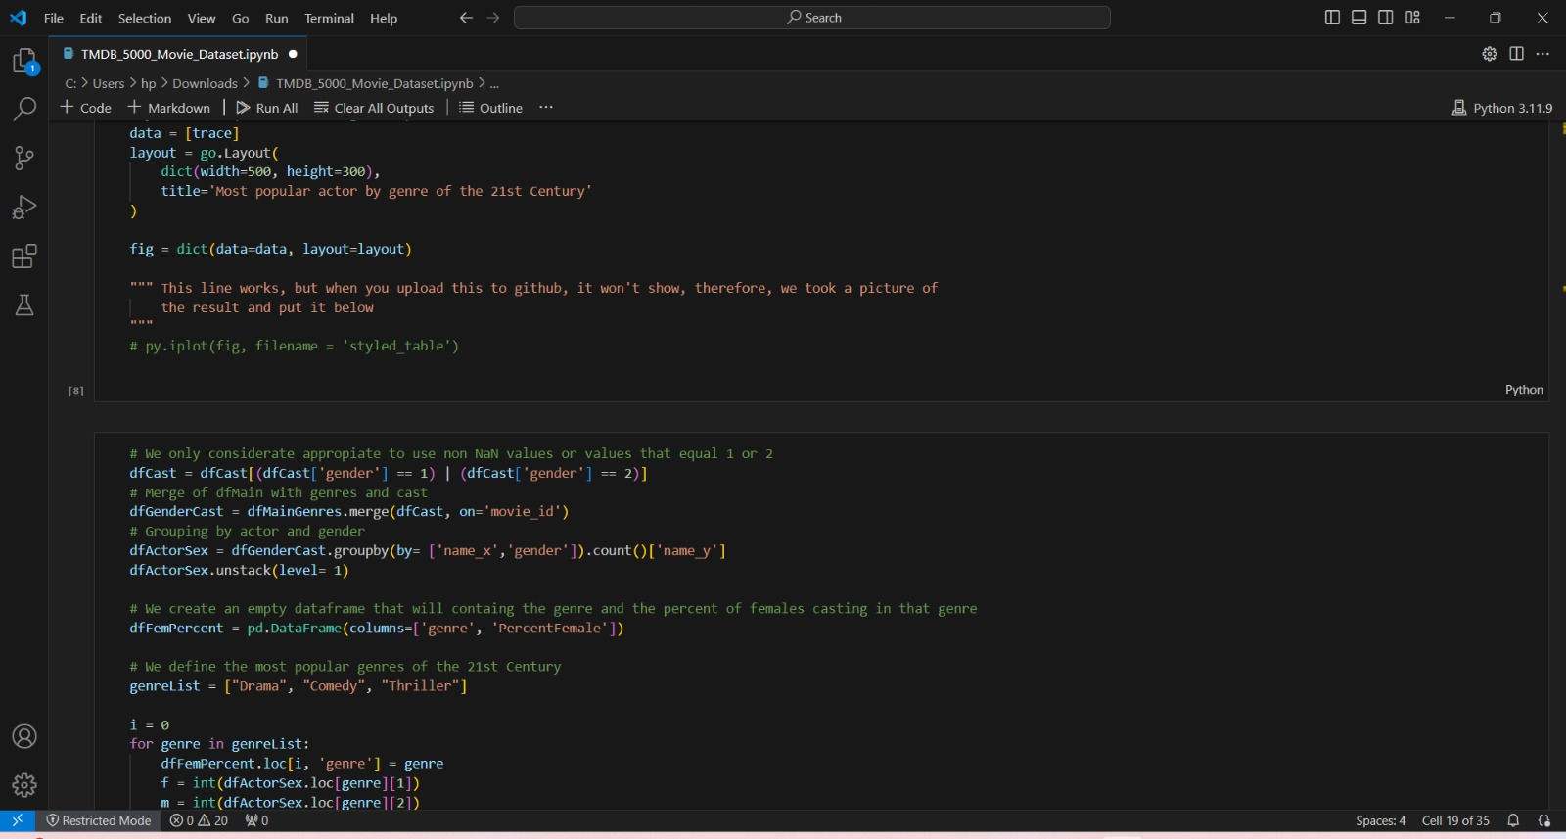
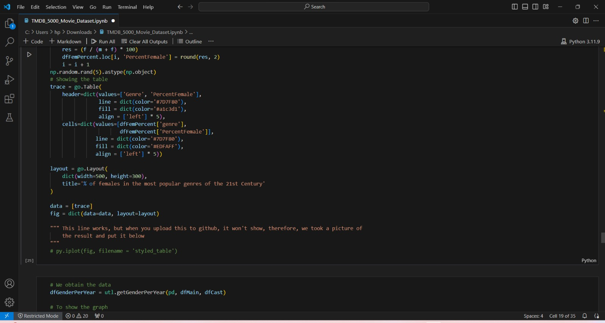

Slide 10
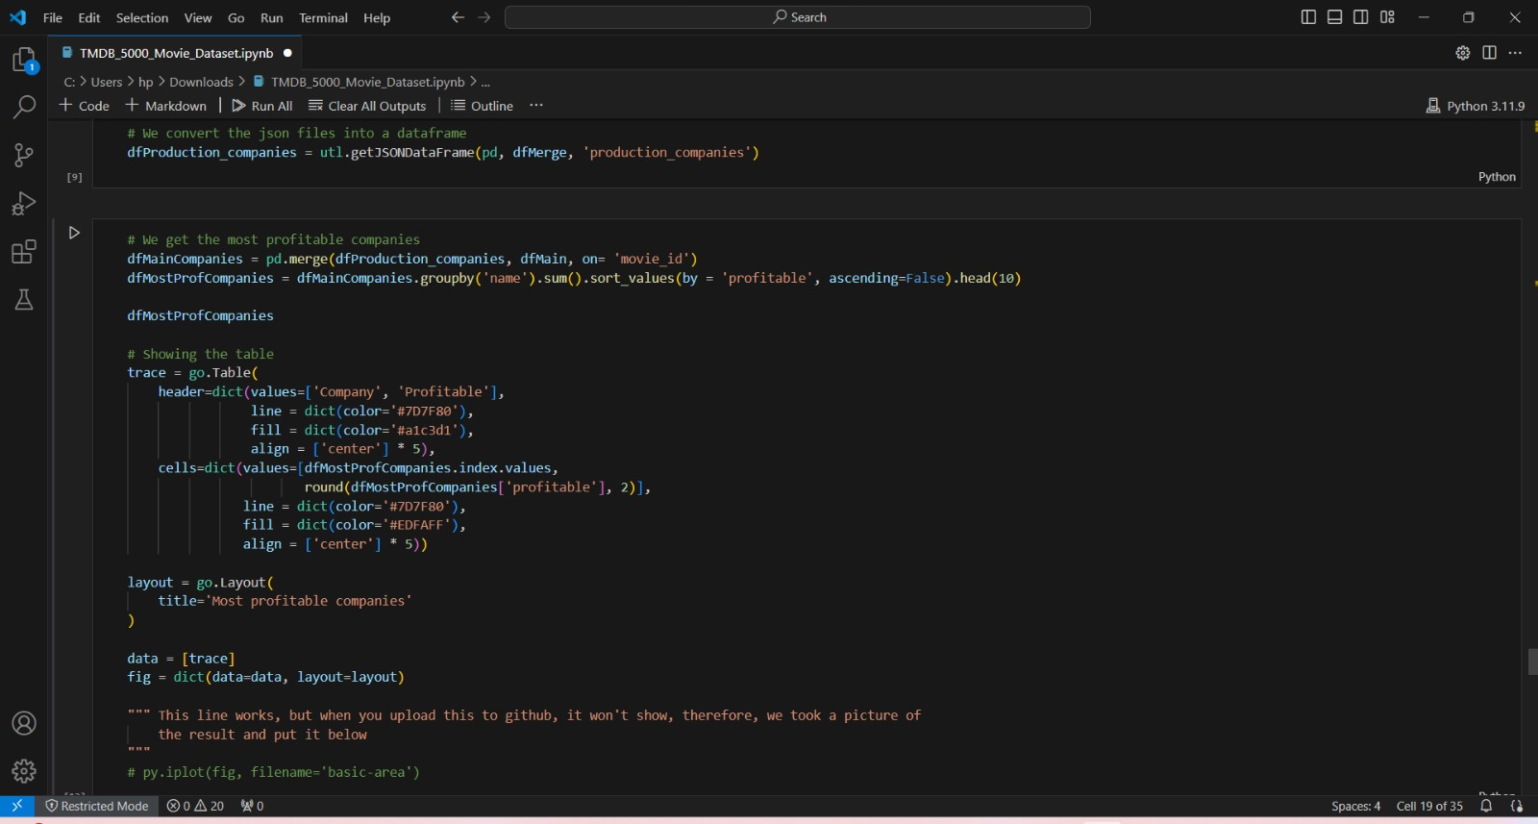
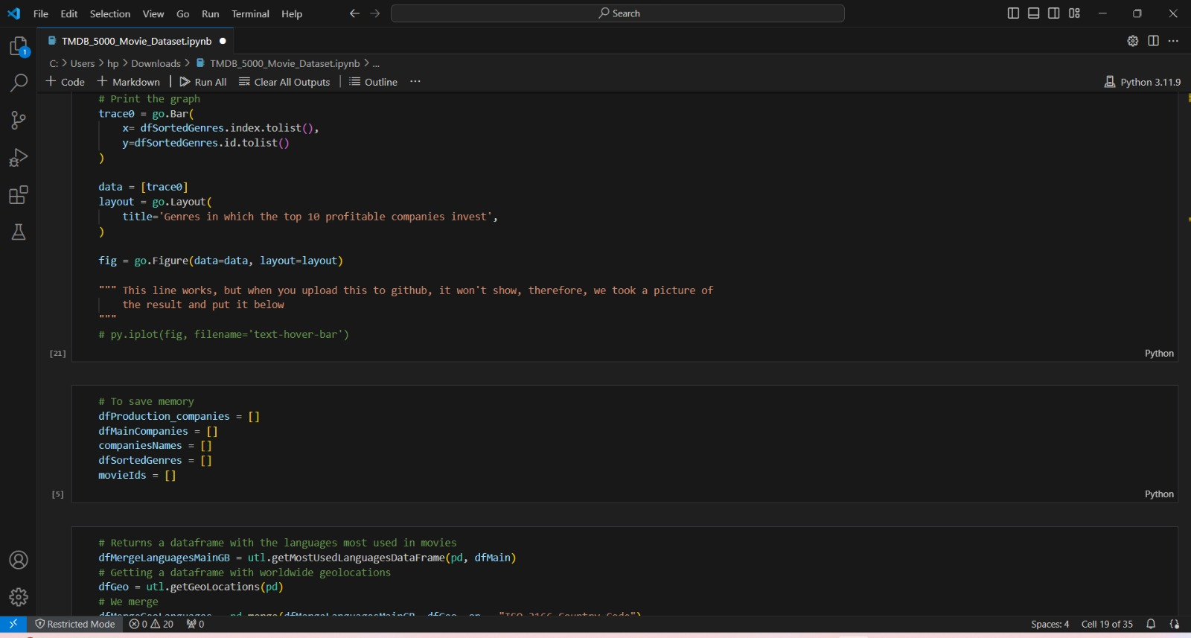
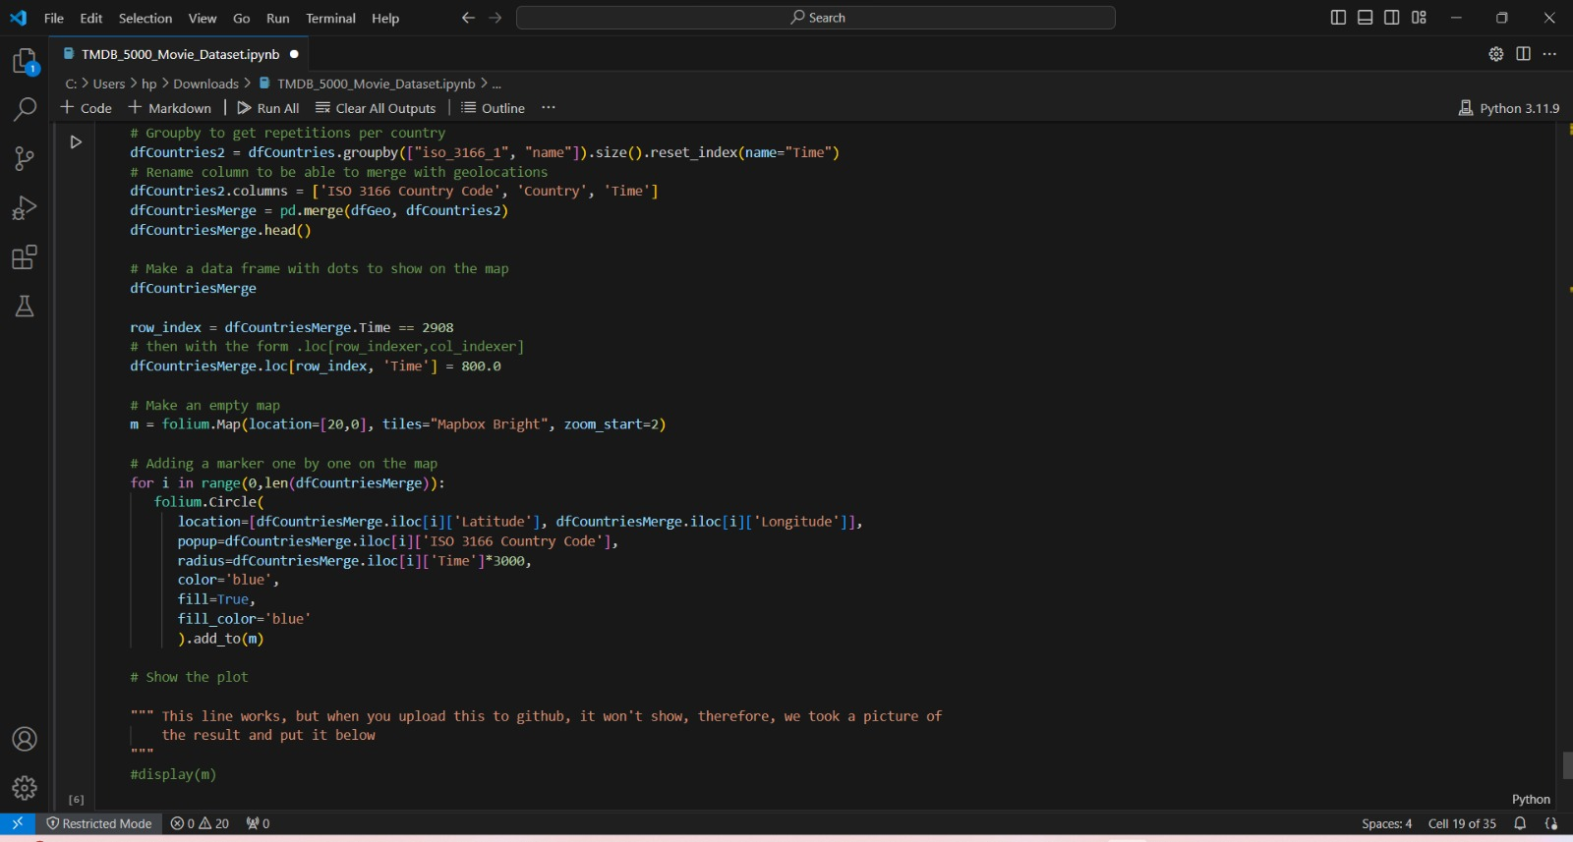
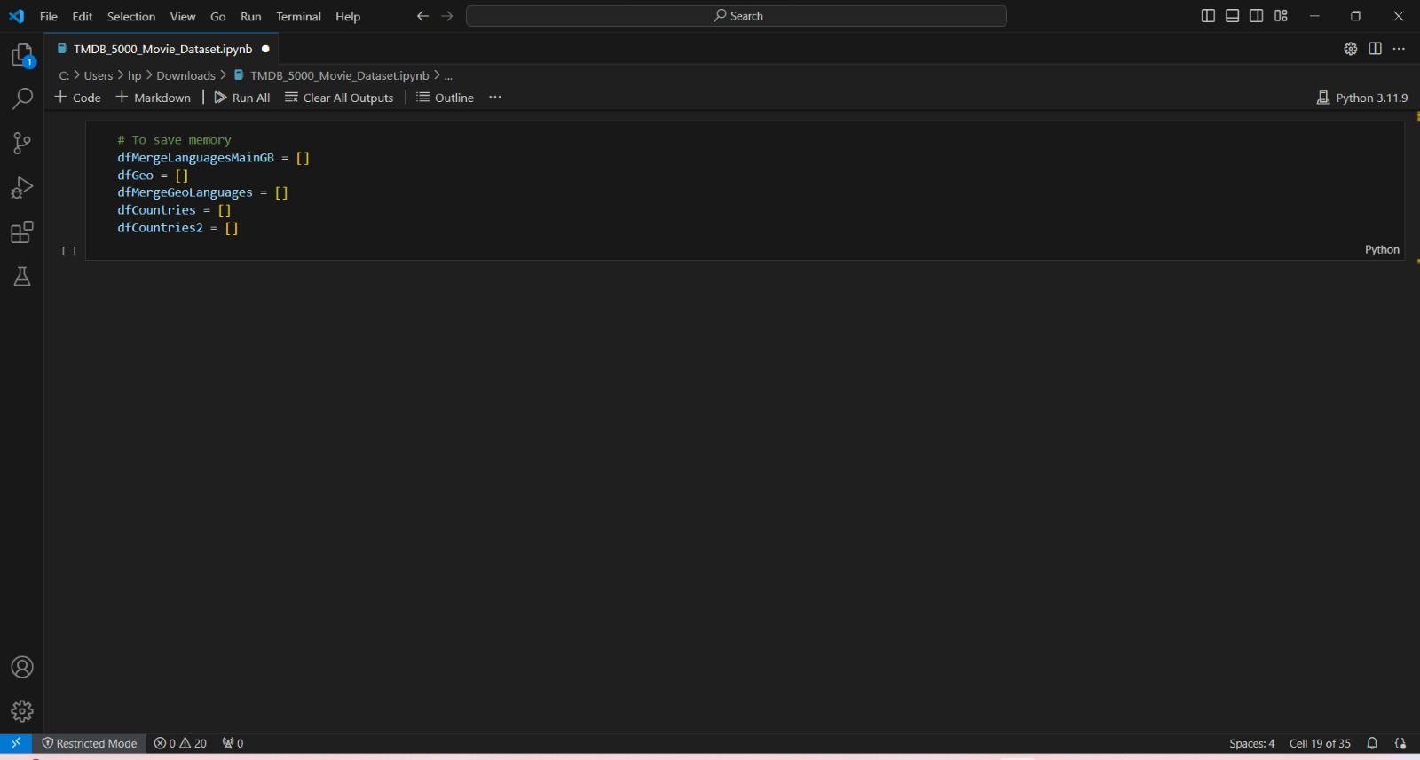

Slide 11
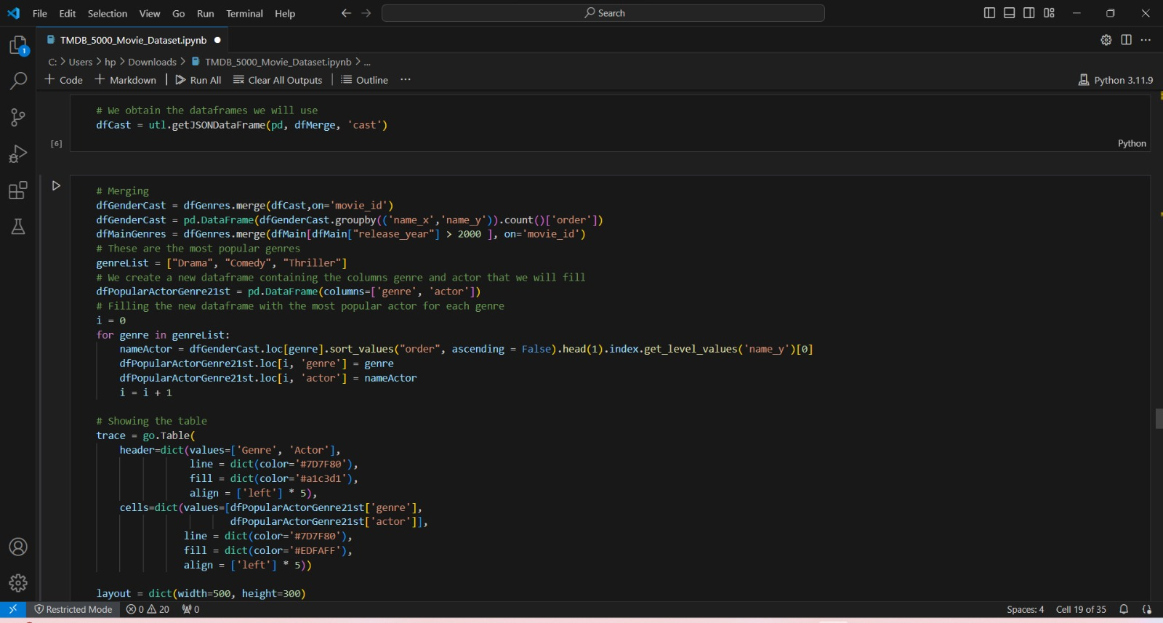
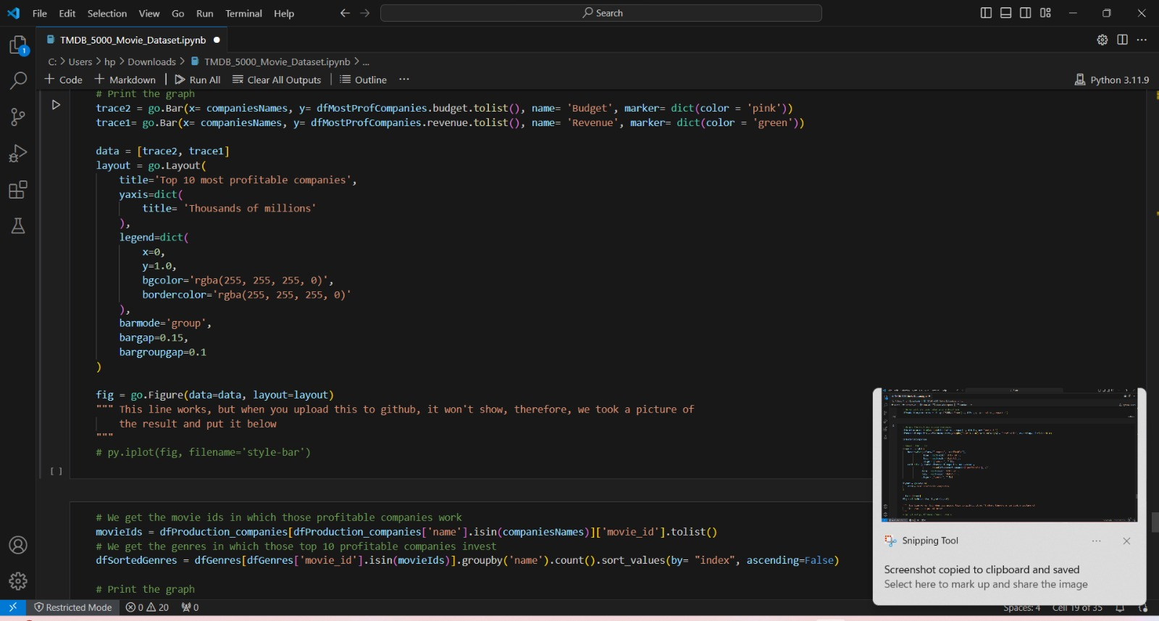
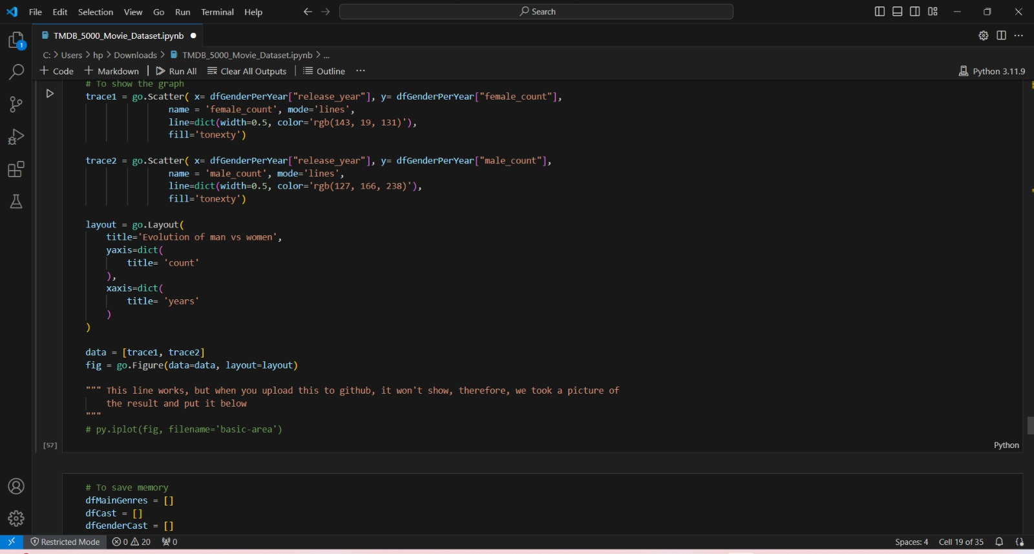
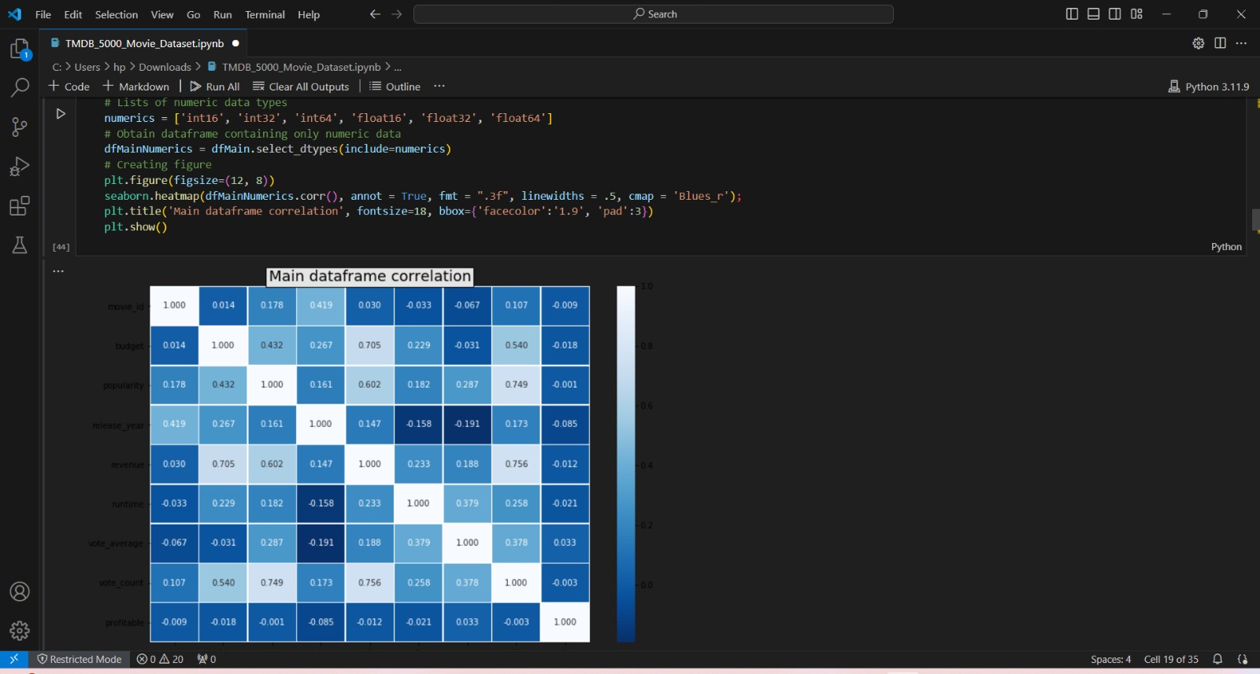

Slide 12
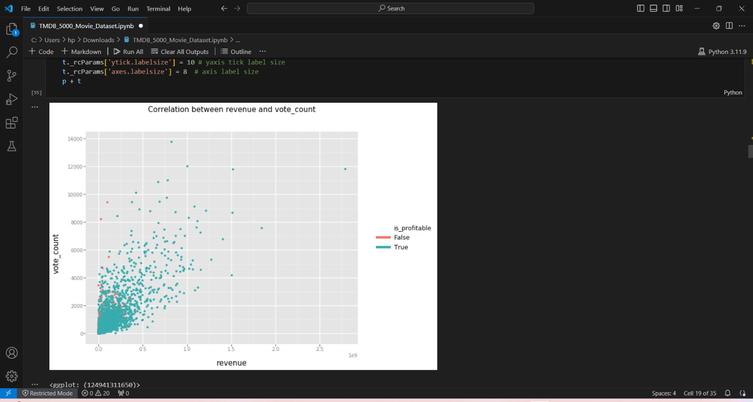
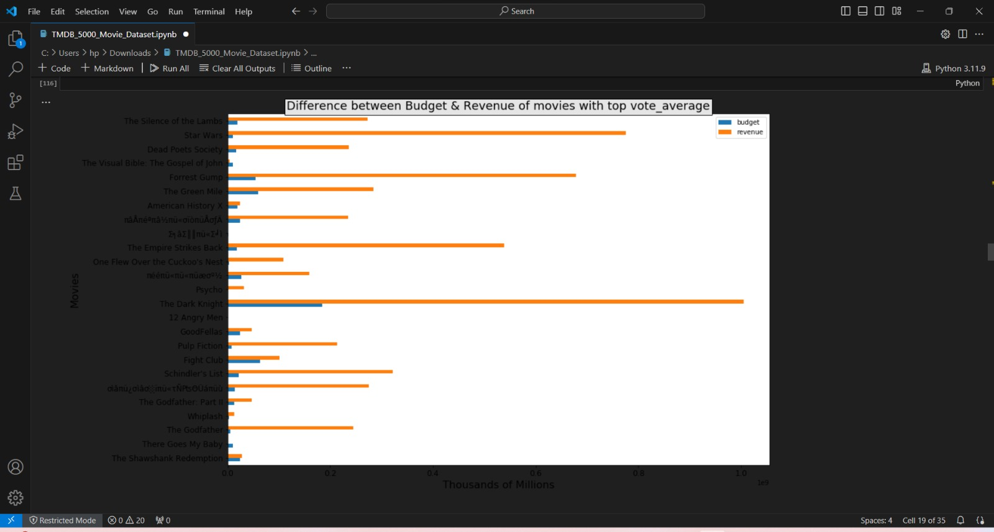

Slide 13
Conclusion
Determinants of Commercial Success: Factors such as budget, genre, director, and cast play a significant role in a movie's box office revenue. Notably, high-budget movies tend to generate more revenue, but with diminishing returns beyond a certain point.
Factors Influencing Critical Acclaim: Attributes like storyline, direction, and acting quality are strong indicators of critical acclaim, as reflected by audience and critic ratings.
Correlation Between Revenue and Critical Acclaim: The relationship between commercial success and critical acclaim is complex. While successful movies often receive positive reviews, critical acclaim does not always guarantee high revenue.
Predictive Modeling: Machine learning models developed from the dataset can predict movie success with reasonable accuracy, providing a valuable tool for stakeholders to estimate outcomes based on specific attributes.
Data Limitations: The dataset, while comprehensive, may have missing or inaccurate information. This can affect the reliability of insights and predictive models.
Complexity of Movie Success: The success of a movie depends on various external factors, such as market trends, cultural context, and competition, which are not fully captured in the dataset.

Slide 14
Future scope
Advanced Machine Learning Models: Explore more complex models like deep learning, ensemble methods, or neural networks to enhance prediction accuracy. Techniques such as ensemble learning can combine the strengths of different models to improve robustness.
Longitudinal Analysis: Study trends over time to understand how factors influencing movie success have evolved. This can involve tracking changes in genres, budgets, and box office returns across different periods.
Model Generalization: Examine the model's ability to generalize to new data. This could involve testing on more recent movie datasets or extending the analysis to international films.
External Data Integration: Integrate additional datasets to provide more context. For example, incorporate data on industry trends, audience demographics, or economic factors to better understand external influences on movie success.
Social Media and Sentiment Analysis: Analyze social media data to gauge audience sentiment and buzz around movies. This can offer insights into marketing effectiveness and public perception.
Streaming Platforms: Include data from streaming platforms to understand how digital distribution affects movie success. Analyze the impact of streaming on traditional box office revenue.
Natural Language Processing (NLP): Apply NLP techniques to analyze movie scripts, reviews, or plot summaries. This can uncover themes, sentiment, and language patterns that correlate with success.
Visual Analysis: Explore image and video analysis to examine cinematographic elements and their impact on movie reception. Techniques like computer vision can help assess visual aesthetics.

Slide 15
References
Original Source: The dataset can be found on Kaggle, a platform for data science and machine learning competitions. The original dataset was uploaded by user "tmdb" and can be accessed
Kaggle Notebook Examples: Many Kaggle users have created Jupyter notebook examples and analyses using the TMDB 5000 Movie Dataset. You can find a variety of analyses, data visualizations, and machine learning models implemented on this dataset by browsing through Kaggle notebooks.
Research Papers: Several research papers have utilized the TMDB 5000 Movie Dataset for various purposes, such as sentiment analysis, recommendation systems, and predicting box office success. Searching academic databases like Google Scholar or arXiv with keywords related to the dataset can lead you to these papers.
GitHub Repositories: Researchers and data enthusiasts often share their code and analyses on GitHub. You can search for repositories related to the TMDB 5000 Movie Dataset to find implementations, data preprocessing scripts, and exploratory data analysis (EDA) notebooks.
Online Courses and Tutorials: Many online courses and tutorials use the TMDB 5000 Movie Dataset as a teaching resource for data analysis and machine learning. Platforms like Coursera, Udemy, and DataCamp may offer courses or tutorials that involve working with this dataset.
Data Science Communities: Websites like Stack Overflow, Towards Data Science on Medium, and Reddit's r/datascience community often feature discussions, questions, and insights related to working with the TMDB 5000 Movie Dataset. You can find helpful tips, code snippets, and best practices shared by fellow data scientists.

Slide 16
THANK YOU

